Slide 1
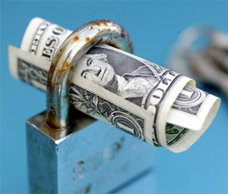
Emancipation in America for the early 21st Century:
Why No one should be a hostage to our health care system

Slide 2
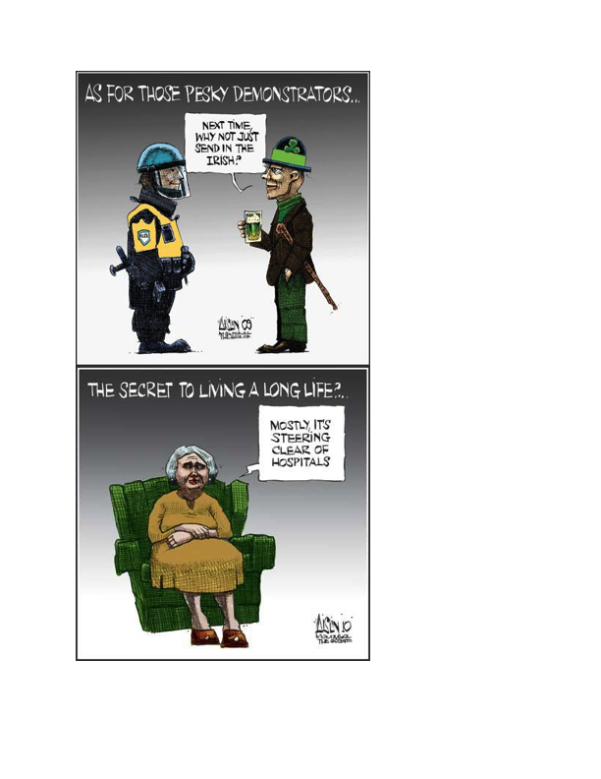
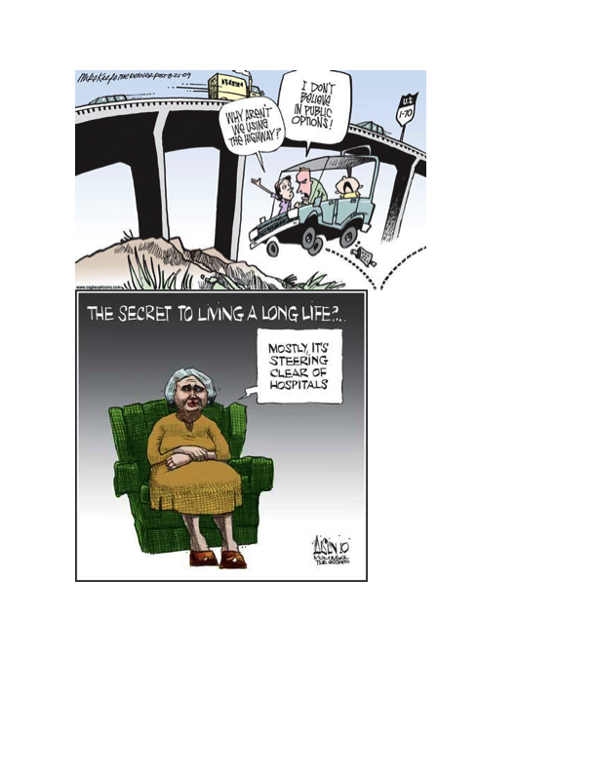

Slide 3
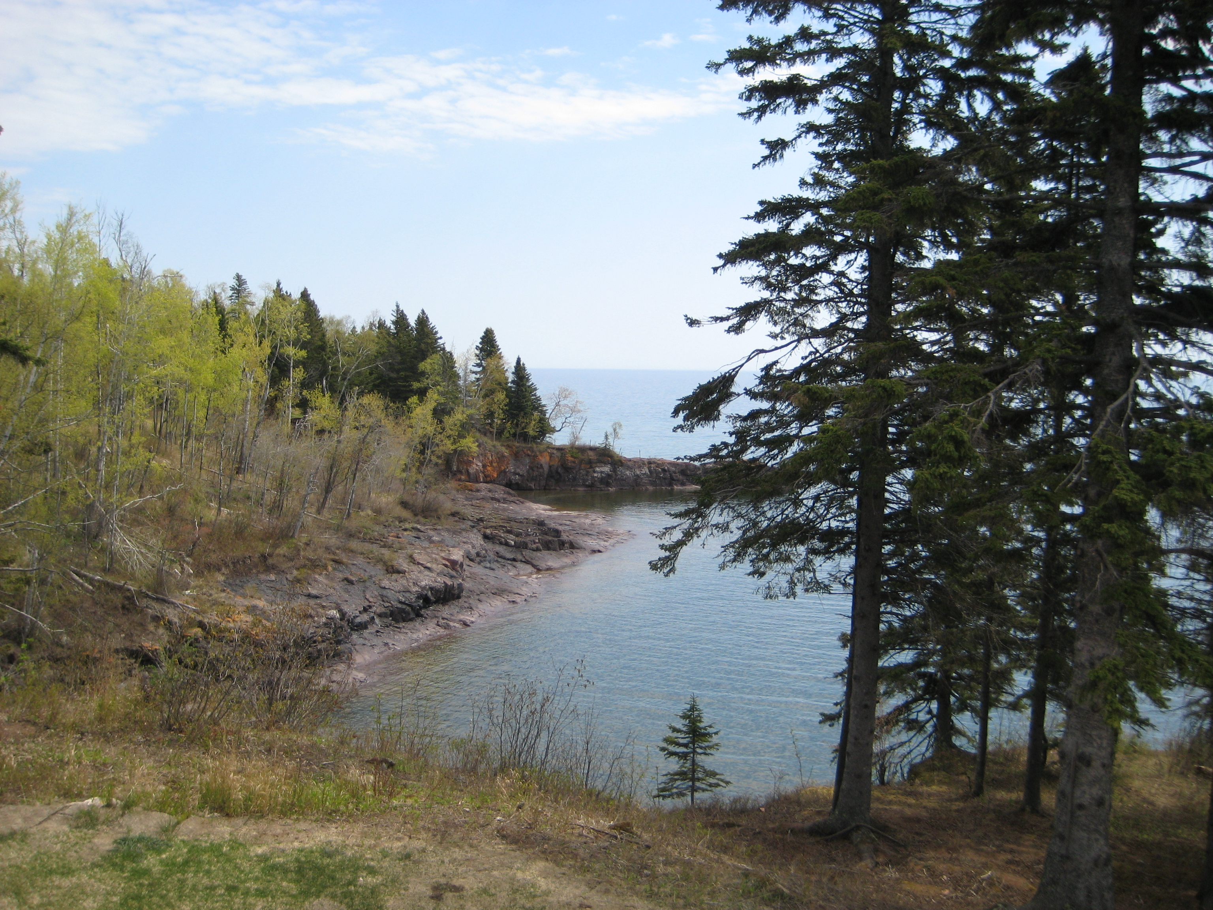
Still waiting for health care reform...Why Single Payer makes sense for Minnesota

Slide 4
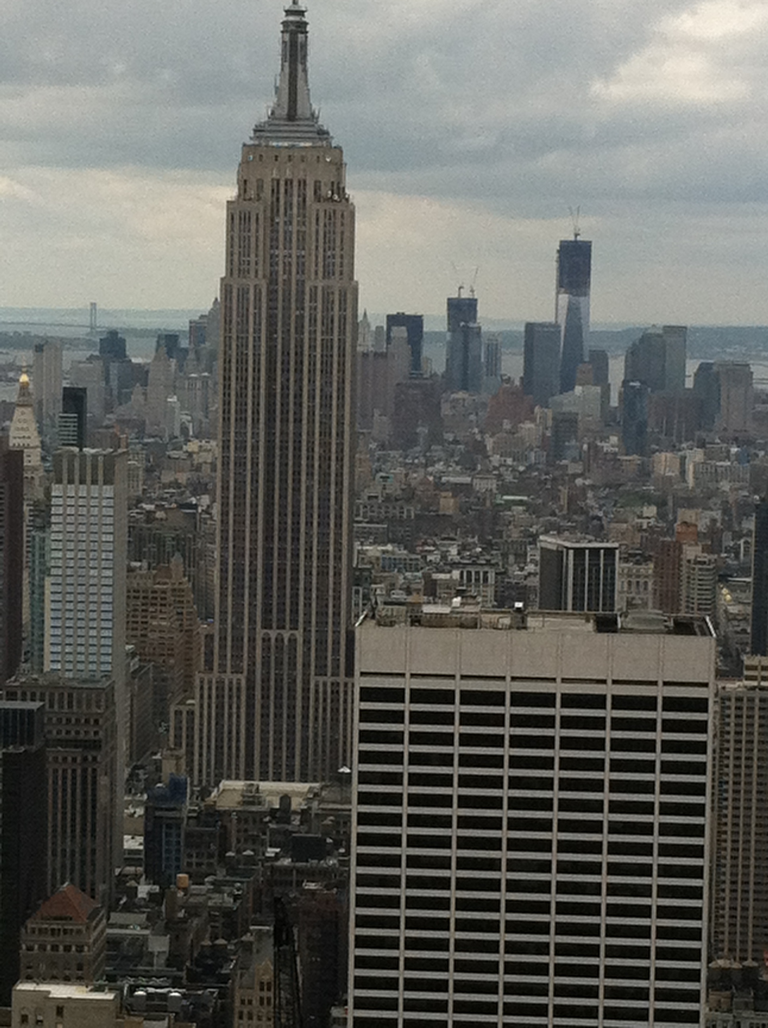
My credentials
Professional:27 years of medical practice as a board-certified urologist both in Canada and the USA.
Social: medical family,” moderate” :,liberal with social issues, conservative leaning with economic policies

Slide 5
If current policies of private health care insurance companies were applied to other life conditions
If your home was lost to a fire,your replacement home could not be insured for further fire damage OR your insurance premium would quadruple
Your automobile insurance would be cancelled after any hit and run accident
After being robbed your police protection would be suspended

Slide 6
Private industry’s principles are applied in the same manner to health as with any other commodity
BUT:we choose to purchase TVs,computers and other items.
We DO NOT choose to be ill

Slide 7
“Capitalistic economic principles cannot be applied in the same manner to health care as compared to products of mass consumption”

Slide 8
A truly modern society of the 21st century
“Every person should have access to adequate food,shelter,clothing and basic health care,no matter what their circumstances”
“no one should be denied adequate health care for the sake of private profit”
The government should assert its moral responsibility to empower and protect its citizens from harm

Slide 9

“no one should face financial penalties because of illness”
At the present time none of the above is applicable to our nation!

Slide 10
The U.S. health care system becomes a more embarrassing disaster each year…
— Donald Kennedy; former editor Science, August 15, 2003
America has the best health care system in the world, pure and simple.
— President George W. Bush, addressing the American Hospital Association, May 1, 2006

Slide 11

Every weekend in America thousands of individuals have to resort to backyard fundraising events to raise funds for medical expenditures.
The vast majority who resort to these desperate measures possess their own private health insurance.
Notes:
11

Slide 12
The private insurance system for delivery of health care in the USA is unable to meet the public need
It’s business plan is in direct conflict with the public’s interest and cannot be sustained
Reasons:
Private insurance averages 30 % for administrative costs (vs. 3% for the VA,Medicare public systems.
Despite being subsidized 60% by the taxpayer, private insurance premiums continue to soar well beyond the actual cost of care
In the last 30 years with private insurance companies basically running our health care system, quality and access has to continue to erode

Slide 13

- National research & education organization of ~ 18,000 members advocating universal, comprehensive, single-payer health insurance
Single-payer care provides a more cost efficient and equitable way to administer high-quality health care
“…access to high-quality health care is a right of all people…”

Slide 14
Objectives
Distinguish single-payer healthcare reform from the ACA
Define the problems of uninsurance and underinsurance
Compare healthcare cost & quality of the US to other industrialized nations
Introduce the Minnesota single-payer movement

Slide 15


Definitions
Universal health care
  Access for all
  Doesn’t specify how
Socialized medicine
  Publicly financed
  Publicly owned
Single-payer system
  Publicly financed
  Privately owned (delivered)

Slide 16
What is Single Payer?
Hospitals & clinics now bill > 1000 payers (insurers)
In a single-payer system, there would be no private health insurance
Recovery of $400 billion annually due to drastically reduced administrative costs
(Steffie Woolhandler et al., “Costs of Health Care Administration in the United States and Canada,” New England Journal of Medicine 2003;349:768-75).
Notes:
Enough to cover the nation’s uninsured children and their families

Slide 17

Adopting a “public” health system is creation of socialized medicine and places the government between you and your doctor”
This is pure rhetoric and is untrue: compare the situation VS. Medicare and VA.
My personal experience as a Canadian physician proves that this is just propoganda

Slide 18

Why Single-Payer?
Access
US
has
major problems in all 3 areas
Cost
Quality

Slide 19
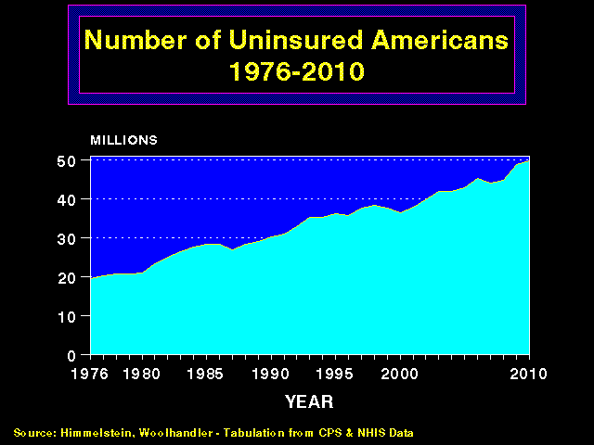

Slide 20
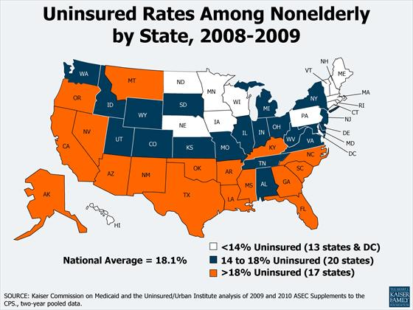
Notes:
In 2009, MN was 3rd in the nation. We had 8.8% uninsured. Only two states (MA and HI) are ahead of us. MA was down to 4.4%.

Slide 21
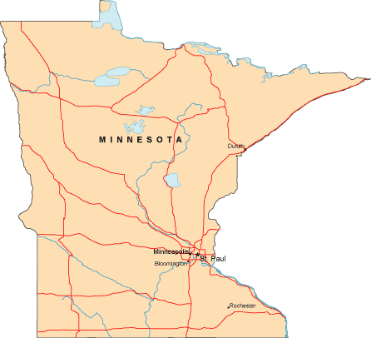
480,000 Uninsured
68% uninsured nonelderly have a full-time worker in the household.
Source: http://www.census.gov/hhes/www/hlthins/hlthins.html

Slide 22
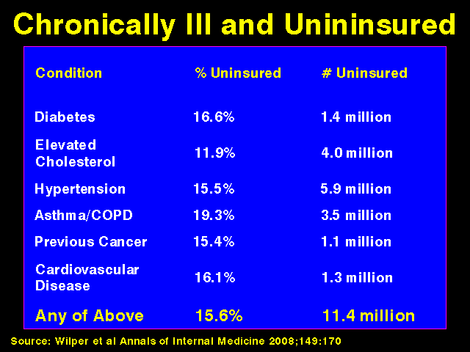

Slide 23
Does being uninsured matter?
45,000 adult deaths/ year
Model adjusted for gender, age, race/ethnicity, income level, education, employment status, smoking status, alcohol use, exercise habits, self-reported health status…
Source: Wilper et al. American Journal of Public Health, 2009
Notes:
IOM estimaged this # at 18,000 in 2001. Current study analyzed data from NHANES III (1988-1994 with f/u through 2000)
23

Slide 24
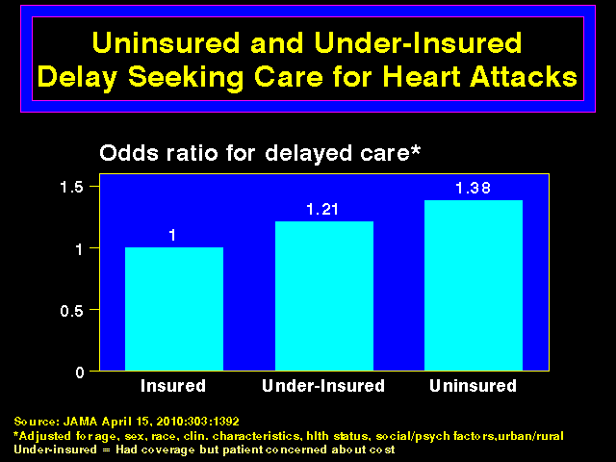

Slide 25
5-Year Cancer Survival
Colorectal cancer: 63% for the privately insured but 49% for the uninsured
Breast cancer: 85% for those with private insurance, 75% for the uninsured
Coleman et al, The Lancet Oncology, Aug 2008

Slide 26
Phew!
Thank goodness that’s not me…

Slide 27
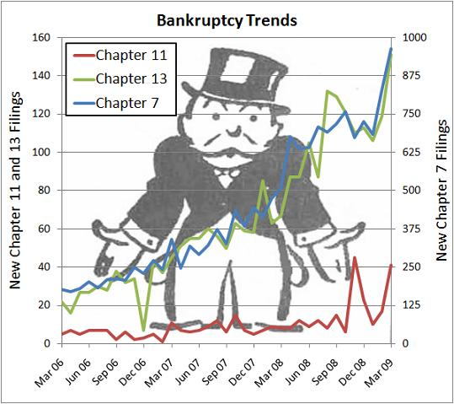
Underinsurance
62% of personal bankruptcies due to medical expenses (2007)
  ^{500,000 people!!!}
78% of people with medical bankruptcies had health insurance when they got sick
“Medical impoverishment, although common in poor nations, is almost unheard of in wealthy countries other than the US.”
Himmelstein et al, American Journal of Medicine, June 4, 2009
Notes:
Historically, role of insurance in society was to allow purchasers to trade uncertainty for certainty.

Slide 28
Why Single-Payer?
Access
US
has
major problems in all 3 areas
Cost
Quality

Slide 29

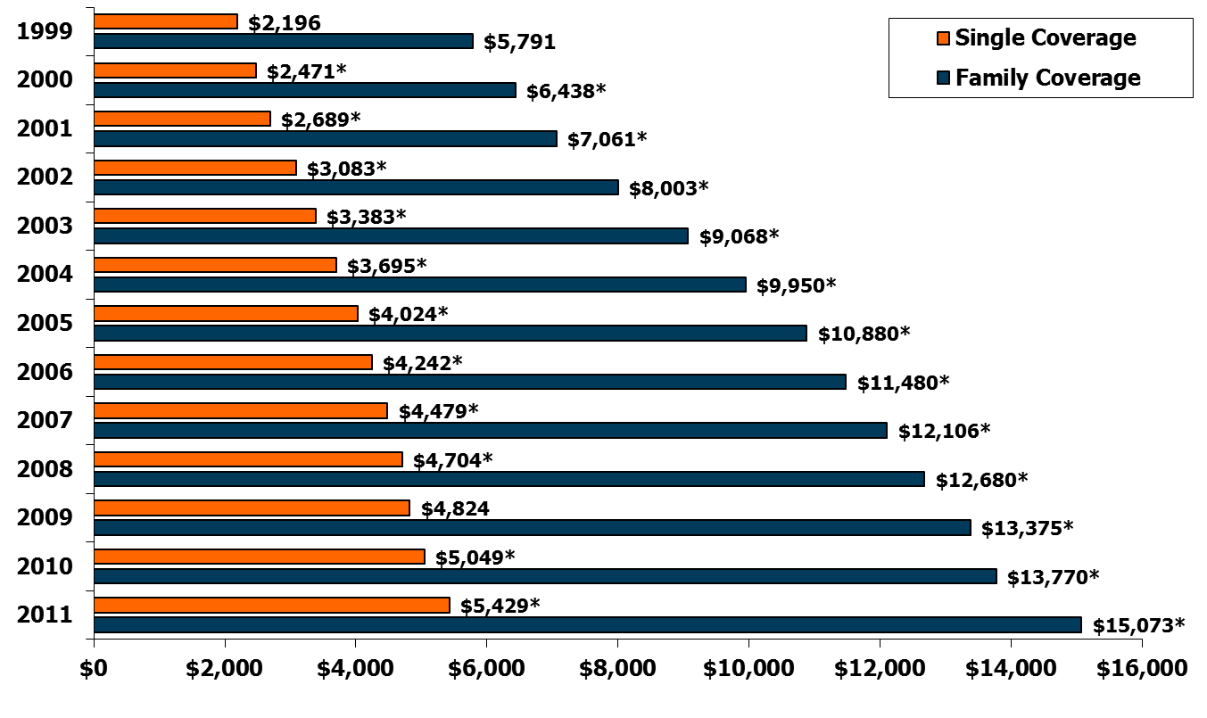
Average Annual Premiums for Single and Family Coverage, 1999-2011
* Estimate is statistically different from estimate for the previous year shown (p<.05).
Source: Kaiser/HRET Survey of Employer-Sponsored Health Benefits, 1999-2011.
Notes:
Average family premium sustained an increased of 9% over the previous year (vs 3% increase b/w 2009 and 2010) - ? spike or new trend. Family coverage has doubled since 2001. Many businesses are citing this as their reason not to hire. This increase far outsripped wage increases over the same period. Employees pay about ¼ of the cost of the premium + other OOP spending.

Slide 30
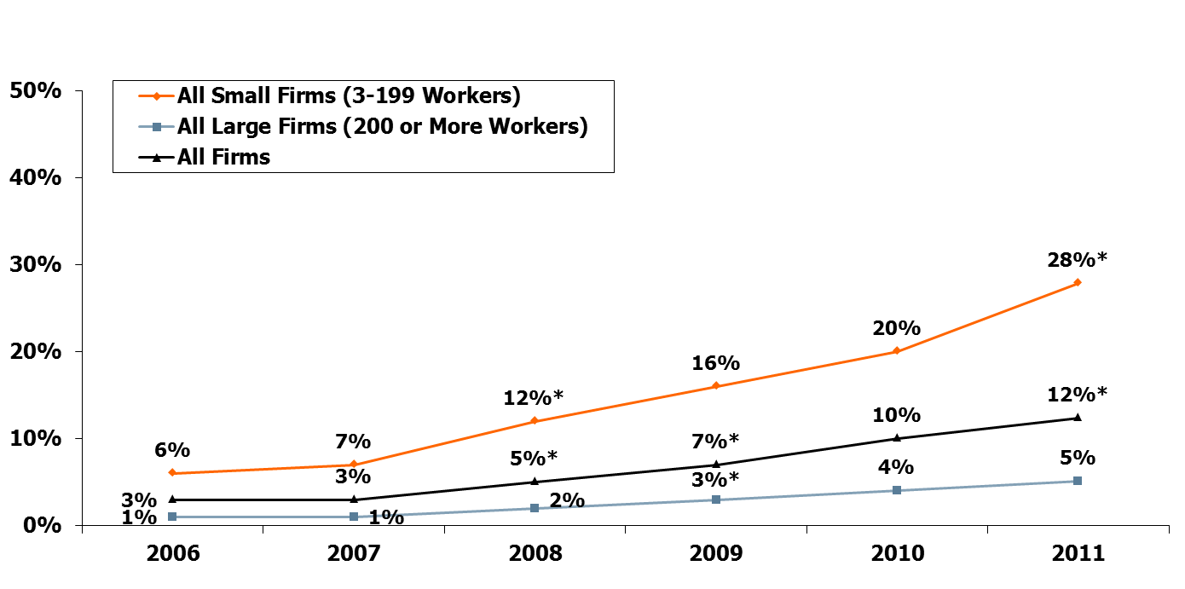
Percentage of Covered Workers Enrolled in a Plan with a General Annual Deductible of $2,000 or More for Single Coverage, By Firm Size, 2006-2011
* Estimate is statistically different from estimate for the previous year shown (p<.05).
Note: These estimates include workers enrolled in HDHP/SO and other plan types. Because we do not collect information on the attributes of conventional plans, to be conservative, we assumed that workers in conventional plans do not have a deductible of $2,000 or more. Because of the low enrollment in conventional plans, the impact of this assumption is minimal.
Source: Kaiser/HRET Survey of Employer-Sponsored Health Benefits, 2006-2011.

Slide 31
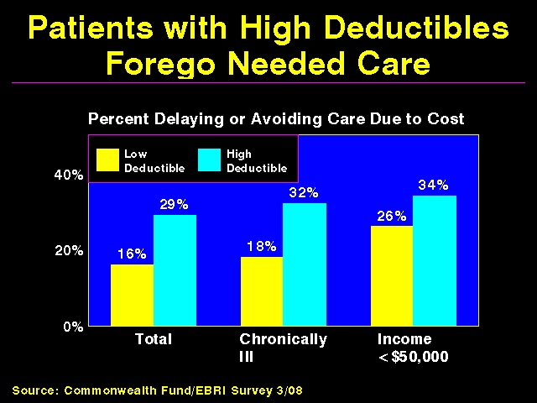

Slide 32

Notes:
Rising costs cannot be halted w/ the status quo.
32

Slide 33
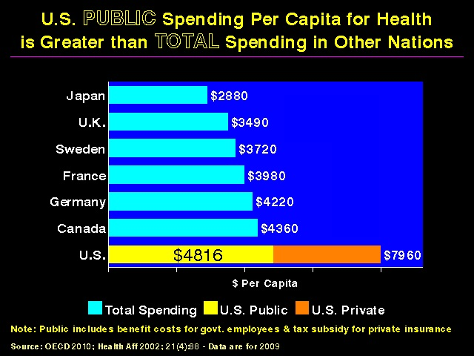

Slide 34

Important fact in the overall analysis: a large percentage of public spending on health care involves the private sector who manage a great proportion of various programs
Eg: Medicare Advantage,Medicaid(U Care in MN)
These corporations receive significant subsidies from the Federal government.
Therefore the taxpayer continues to add to the corporate bottom line !

Slide 35
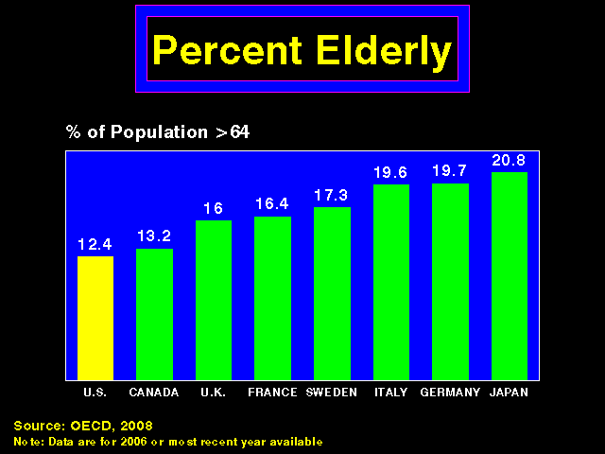
Notes:
The OECD is an inter-governmental international organization that brings together the most industrialized countries of the market economy. They meet with the purpose of exchanging information and bringing policies into line with the goal of maximizing their economic growth and contributing to their own development and to that of the non-member countries.
Similar graphs for tobacco and Etoh use.

Slide 36
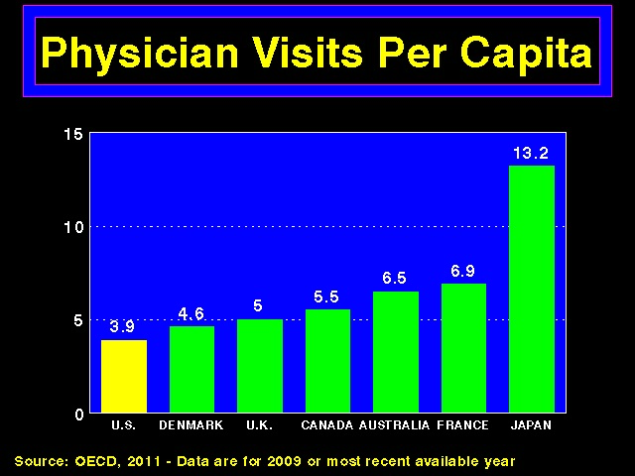
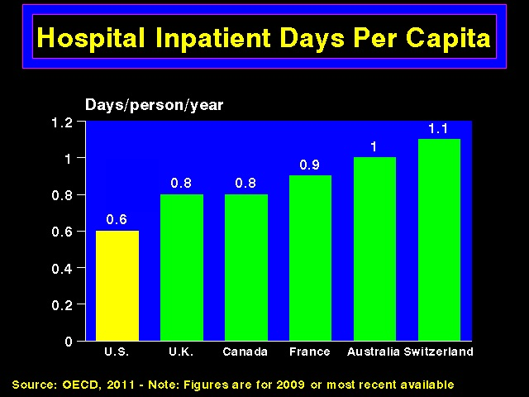

Slide 37
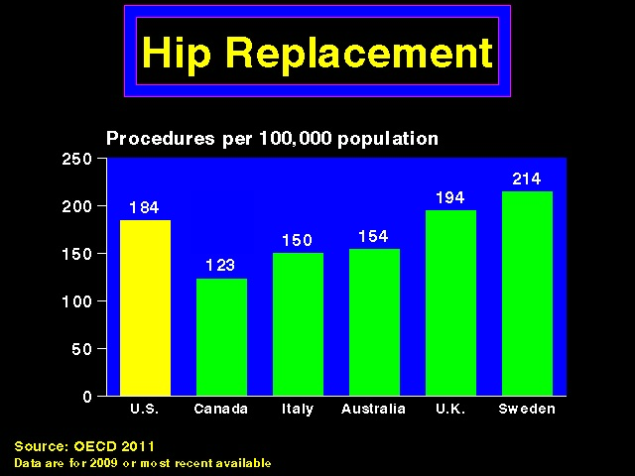
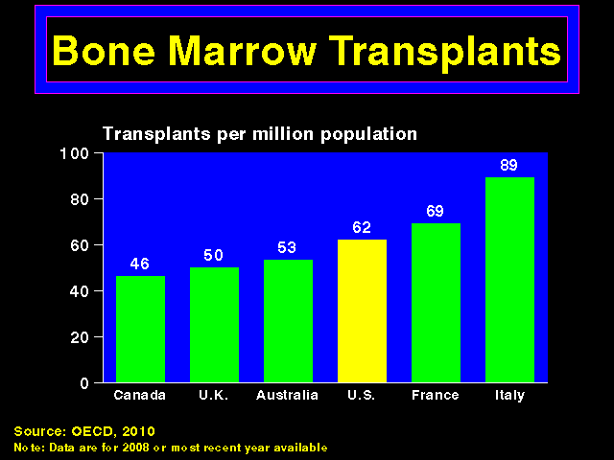

Slide 38
Why Single-Payer?
Access
US
has
major problems in all 3 areas
Cost
Quality

Slide 39
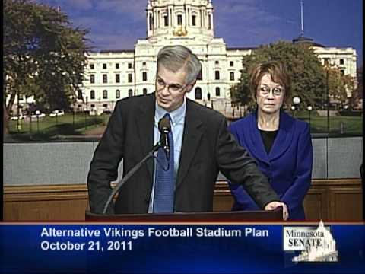
“The USA has the very best health system in the world” (Rep. Linda Runbeck,my own legislator in the Minnesota House)

Slide 40
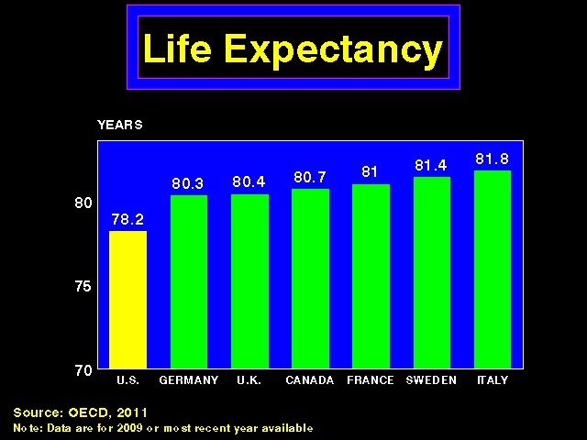
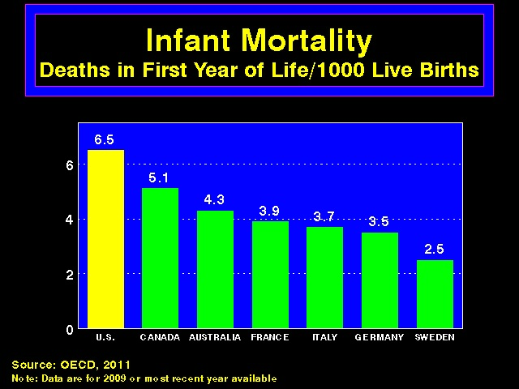
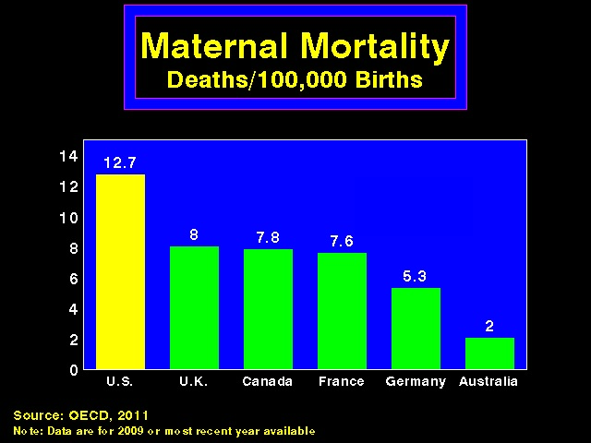
US ranked 37th by the WHO World Health Report
Notes:
Although a number of factors beyond the health care system influence the health of populations, for conditions amenable to medical treatment the health care system is a major determinant of outcomes

Slide 41
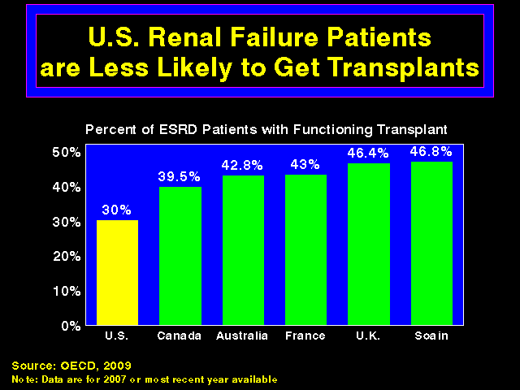

Slide 42
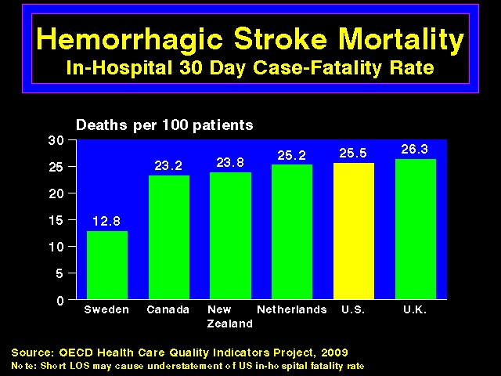

Slide 43
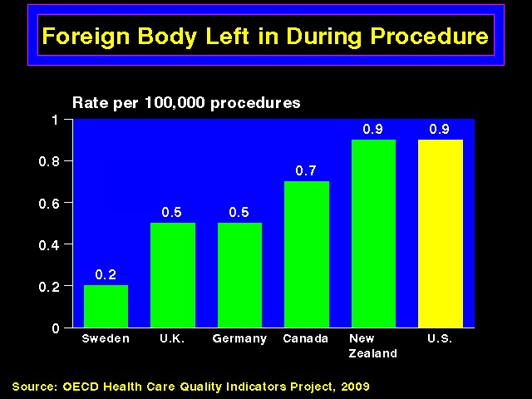

Slide 44
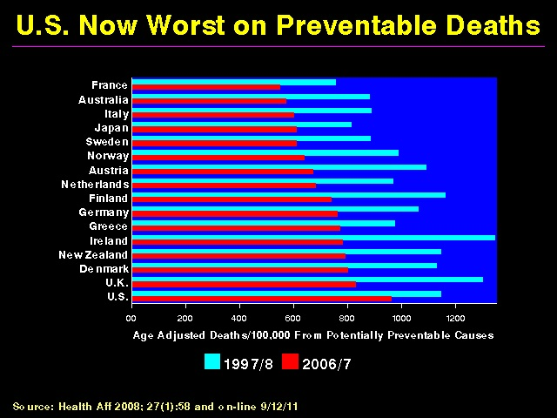
Items include bacterial infections, DM, HTN, common surgical procedures (eg. appendicitis), easily preventable or treatable cancers (cervix, testicular respectively).
Notes:
Study analyzed mortality (under age 75 and excluding infants) in 19 industrialized countries from causes potentially amenable to timely & effective healthcare. Amenable conditions are those from which it is reasonable to expect death to be averted after the condition develops. Items include bacterial infections, DM, HTN, common surgical procedures (eg. appendicitis), easily preventable or treatable cancers (cervix, testicular respectively).
If US performed at the level of the top 3 countries, 101,000 deaths would be avoided.
Eight countries moved from ICD-9 to ICD-10 including US.
Underperformance of the US healthcare system.

Slide 45
Why do we pay more and get less?
31 cents of each healthcare $ is spent on administration
Administrative spending comes from two sides:
  Providers
  Payers
(Steffie Woolhandler et al., “Costs of Health Care Administration in the United States and Canada,” New England Journal of Medicine 2003;349:768-75)

Slide 46
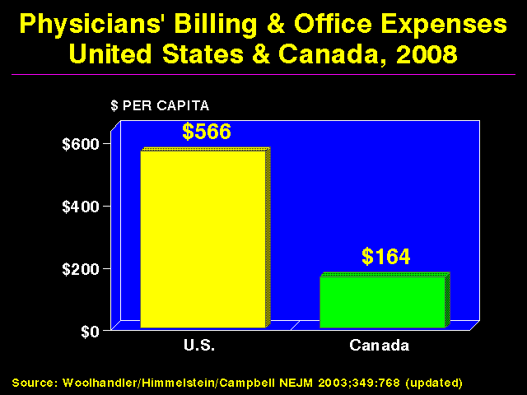
This is a result of the high cost of billing, documentation and hassling with the insurance companies
My cost for billing the provincial(Quebec) government was 1% of my income!

Slide 47
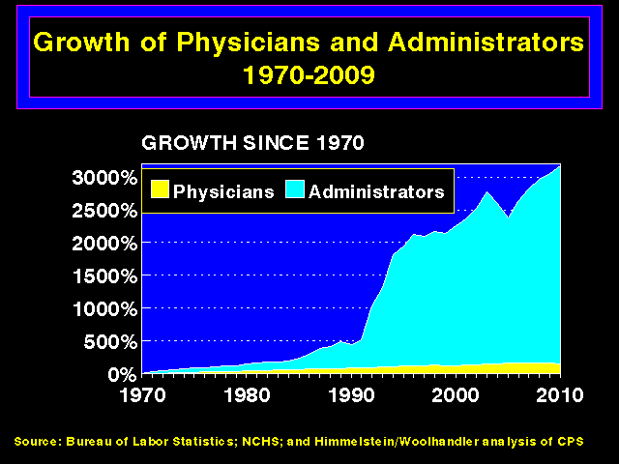
Notes:
“Difficult job to have excess capacity and technology and keep sick patients away from it.” – David Himmelstein

Slide 48
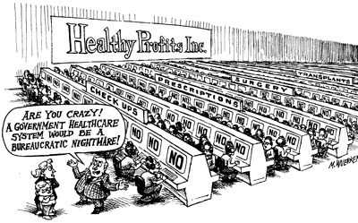
Notes:
Money-changers and paper-pushers thrive chasing the money to pay for care -- not deliver it. In our complex, multipayer system, chasing money is expensive work.

Slide 49
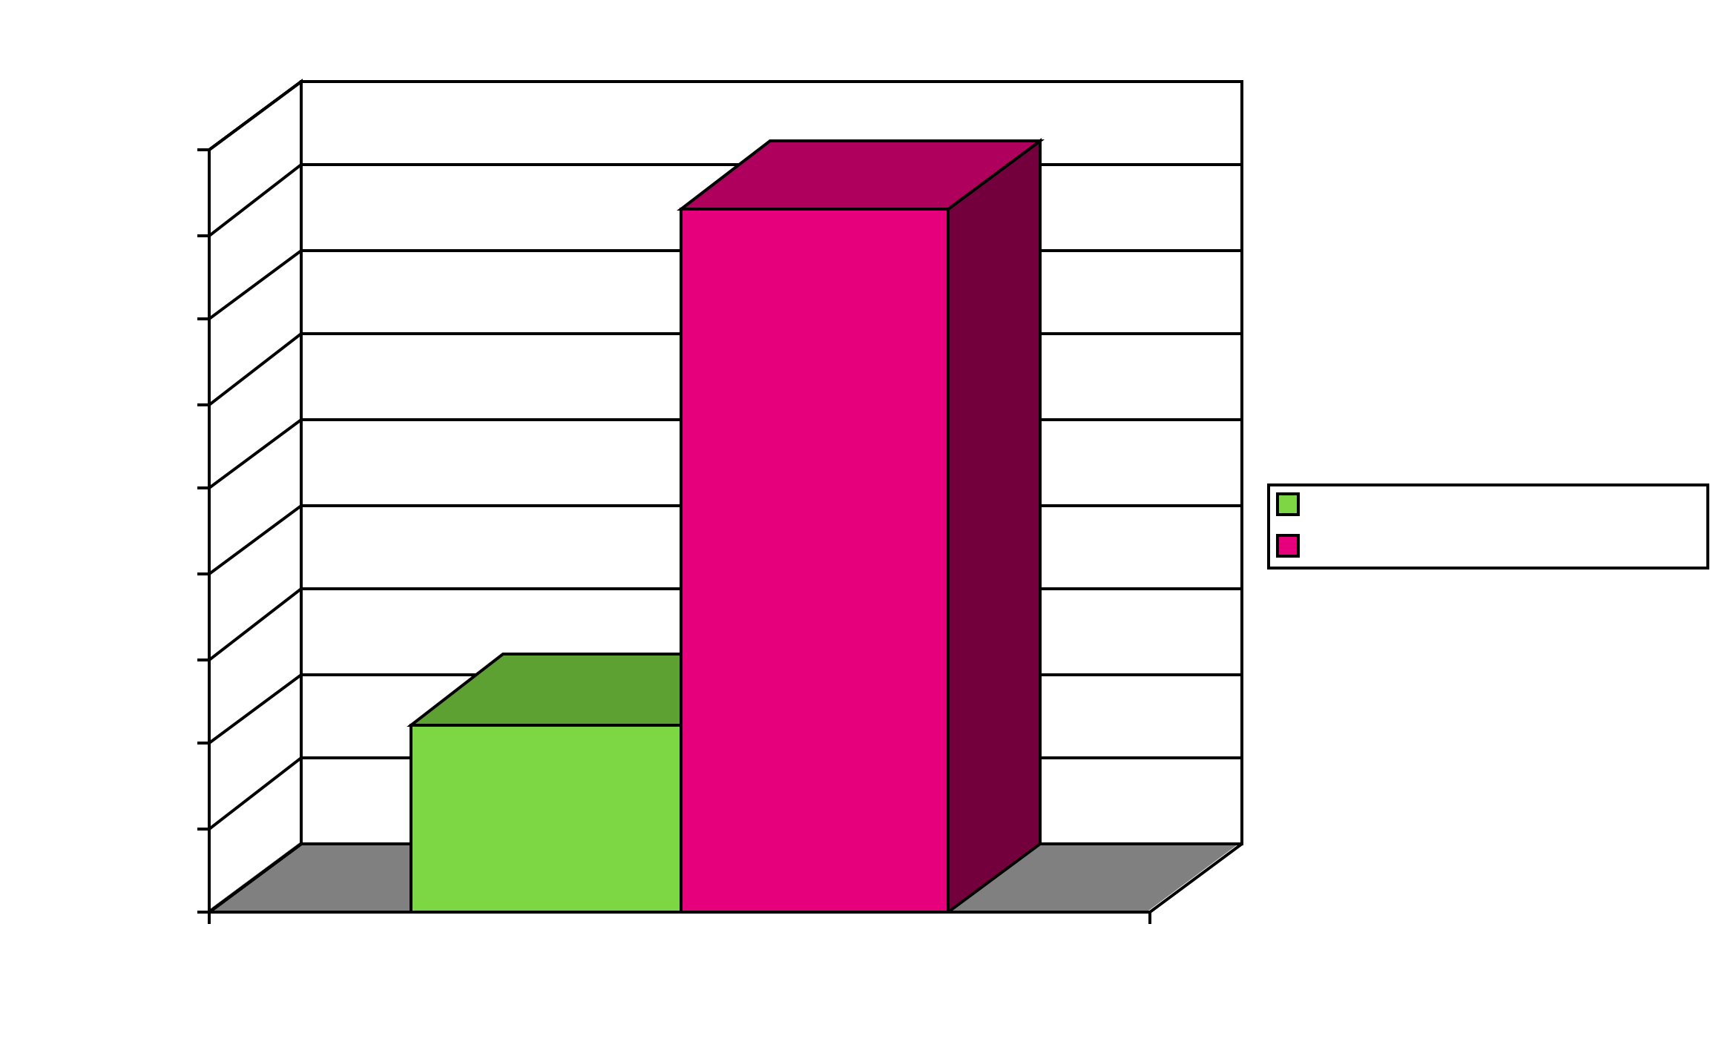
Interactions between physician practices & insurers are costly
Morra et al, Health Affairs, August 2011, 30:8, 1443-1450
Notes:
Different formularies
Prior authorizations
Different rules for billing, claims submission, and adjudication
24% of the average hospital budget is devoted to billing.
U.S. physicians’ office staff spent 20.6 hours per physician per week interacting with health plans — nearly ten times that of their Ontario counterparts.

Slide 50

Interactions between physicians and payers are time-consuming
Primary care doctors: 3.5 hours/week directly interacting with health insurance companies
RN/LPN/MAs: 3.8 hours/week
Casalino, L.P. et al. Health Affairs, 2009. 28(4): p. w533-w543.
Notes:
Higher for smaller practices; lower for specialists.
Main tasks: dealing with formularies and obtaining authorizations
Remember, this is in addition to full-time clerical staff who are presumably spending 40 hours/week on these tasks!!

Slide 51
Why do we pay more and get less?
31 cents of each healthcare $ is spent on administration (Privare insurers)
Administrative spending comes from two sides:
  Providers
  Payers
(Steffie Woolhandler et al., “Costs of Health Care Administration in the United States and Canada,” New England Journal of Medicine 2003;349:768-75).

Slide 52
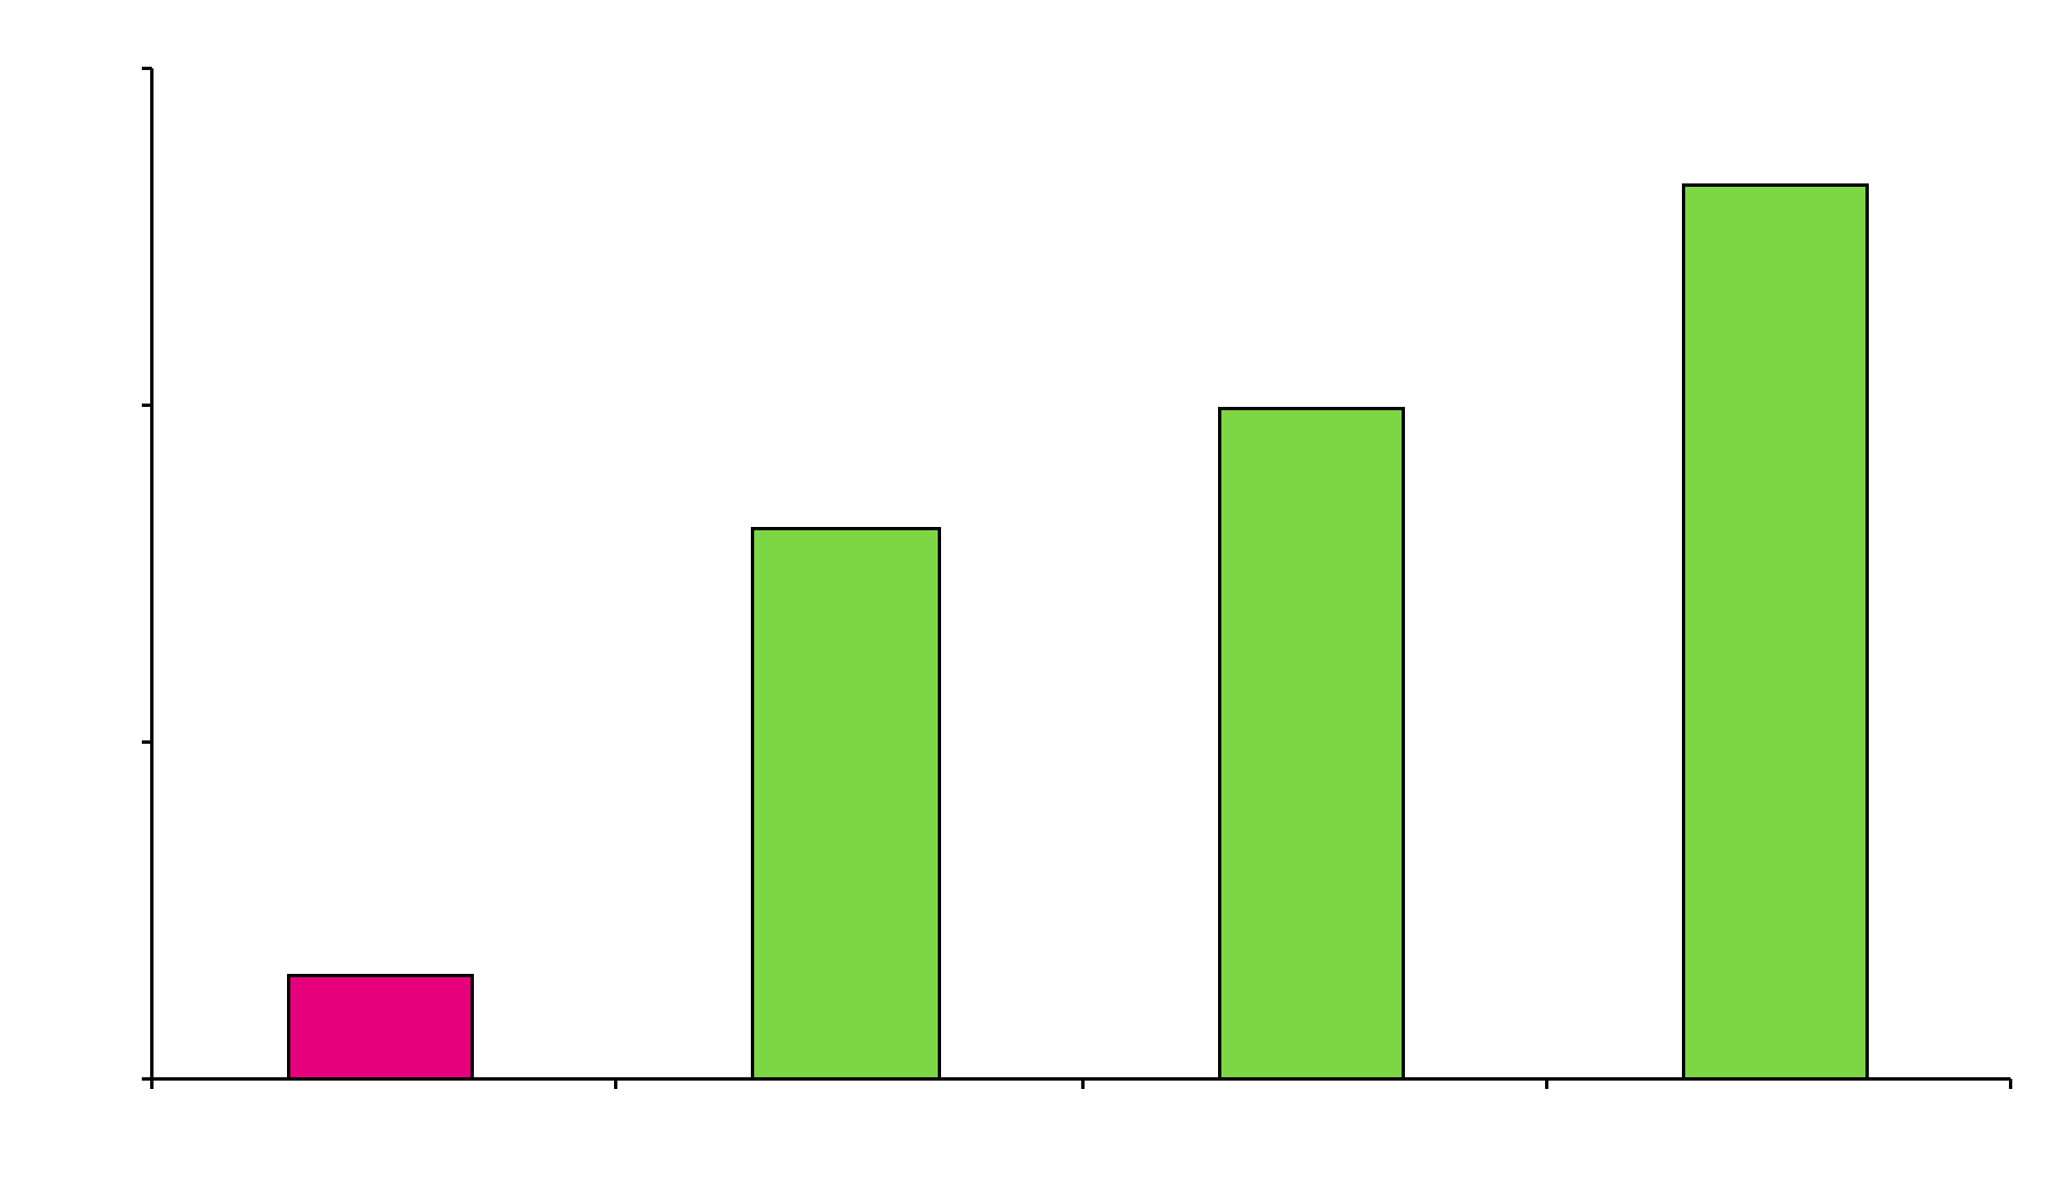
Insurance (Payer) Overhead
International Journal of Health Services 2005; 35(1): 64-90
Notes:
52
52
Medicare pays little or nothing for marketing, underwriting (doing research on people’s health histories and adjusting premiums accordingly), lobbying and profit. Keep in mind the other expenses in insurance system: administration, profits

Slide 53
Reasons for higher administrative costs
Advertising/marketing
Enrolling/disenrolling
Underwriting
Denial of claims
Deciding what to cover (exclusions, pre-existing conditions)
Negotiating multiple contracts with providers
Lobbying ($1.2 billion in 2009)
Salaries (CEO pay at top 10 insurers in 2009 = $228 million)
$$$(Profits!) (Top 5 insurers reported $11.7 billion in 2010)

Slide 54

April 13, 2011
UnitedHealth Group Inc. CEO Stephen
Hemsley took home $48.8 million in total
compensation in 2010.

Slide 55
Admin costs of private payers versus Medicare:
Do these “services” make our patients healthier?
Should we be spending these healthcare dollars on healthcare??
Do these “services” help you as a doctor to diagnose, treat, or prevent illness?

Slide 56
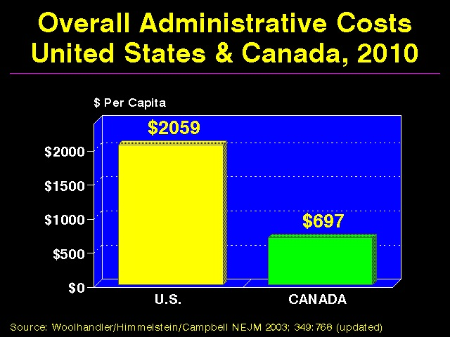

Slide 57
But didn’t we just pass historic national reform?
Individual Mandate
  Mandated health insurance for some (23 million will remain uninsured in 2019)
  Policies required to cover at least 60% of costs
  Raises costs
“While the legislation will enhance access to insurance, the trade-off will be an accelerated crisis of costs and perpetuation of the current dysfunction…” – Jeffrey Flier, dean of Harvard Medical School
Notes:
New healthcare reform bill is akin to building a 3rd story on to a house w/ crumbling foundation.
Community health centers receive extra $1 billion

Slide 58
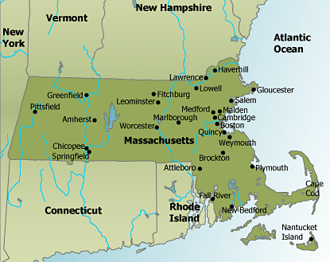
Massachusetts: Required Coverage
(56 y/o male with income > $32,000)
Premium: $5,600
$2000 deductible
20% co-insurance once deductible reached
Notes:
$32,000 = 300% of FPL
American Journal of Medicine, March 2011: medical bankruptcies essentially unchanged b/w 2007 and 2009
$7,600 x 4 = $30,400

Slide 59
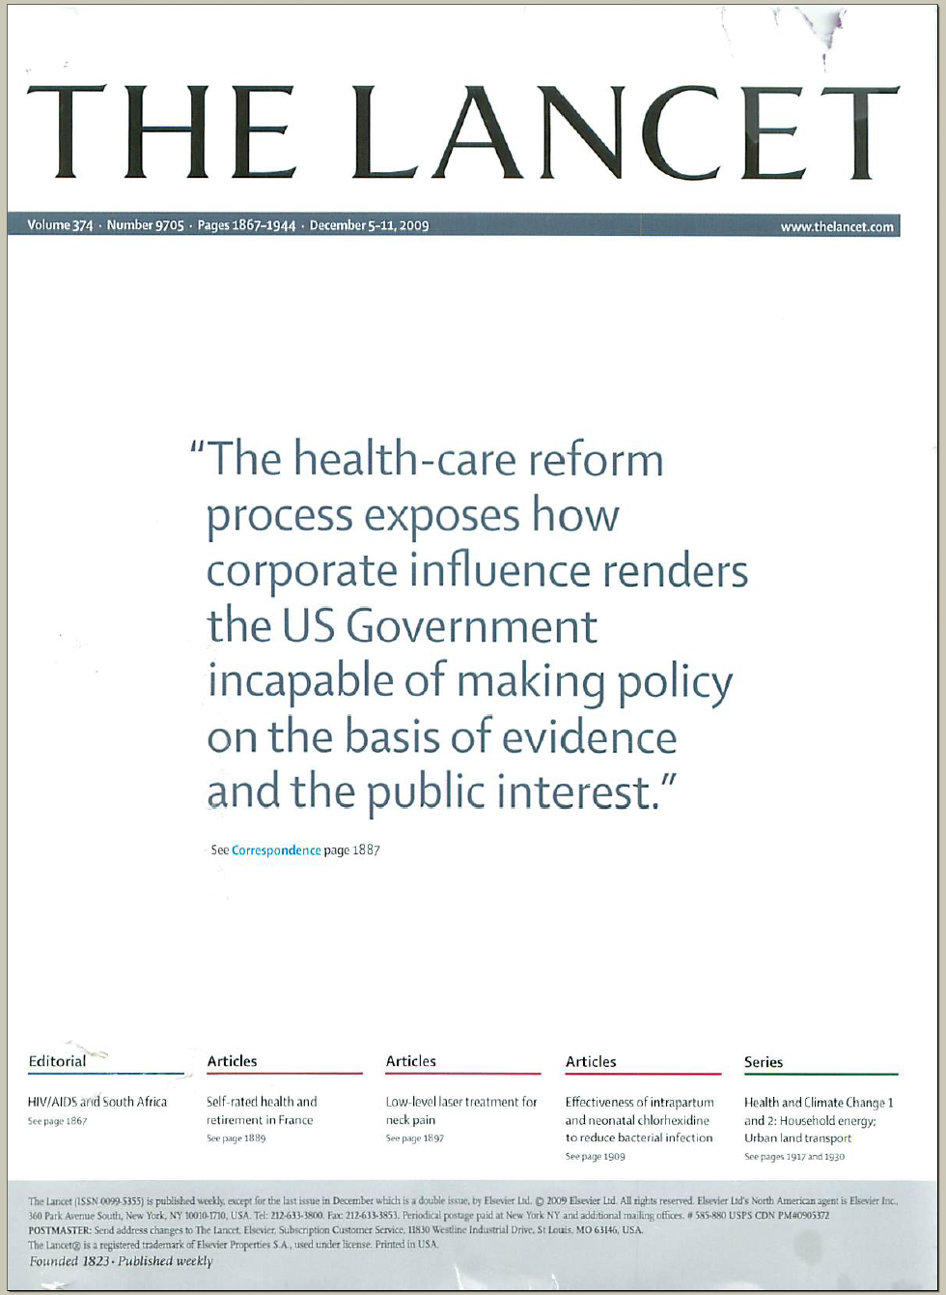

Slide 60
Is it feasible???
We already have…
  Excellent hospitals and well-trained professionals
  A nation of vast wealth with sufficient spending
  Acceptance of pooled resources to publicly fund the military, the NIH, the CDC, highways and roads, schools, libraries, police and fire services, water sanitation, etc.
And…
  Every other industrialized nation is doing it!

Slide 61
In the end, all money for healthcare comes from individual households...
INDIVIDUAL
HOUSEHOLDS
Individual health insurance
Taxes for Medicare and Medicaid
Lower wages
Out of pocket
Private employers pay for health insurance
Property taxes
Higher prices for goods
Health insurance for public employees
Notes:
61

Slide 62

What do doctors think of single-payer?
5000 surveys, 2007: 51% response rate
“In principle, do you support or oppose government legislation to establish national health insurance?”
59% supported (49% in 2002)

Slide 63
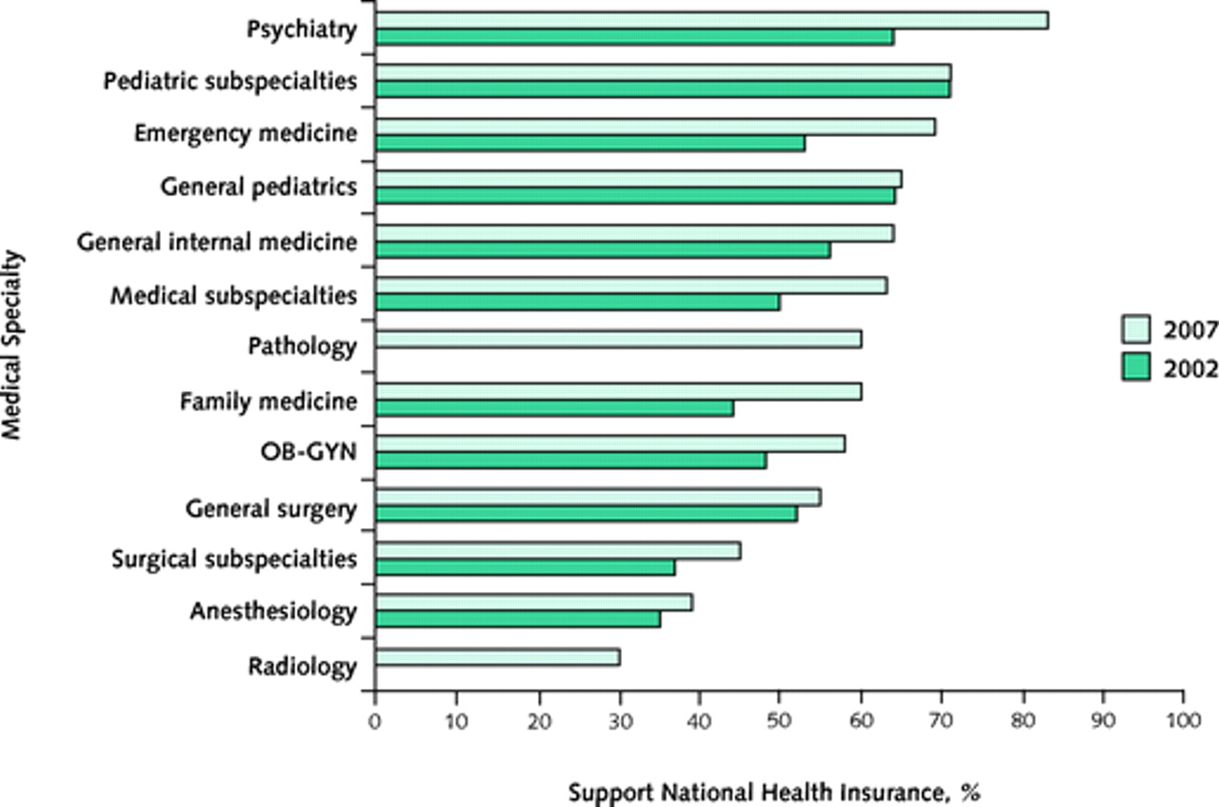
Support for government legislation to establish National Health Insurance in 2007 and 2002, by specialty
Annals of Internal Medicine, 1 April 2008, Volume 148 Issue 7, Pages 566-567

Slide 64
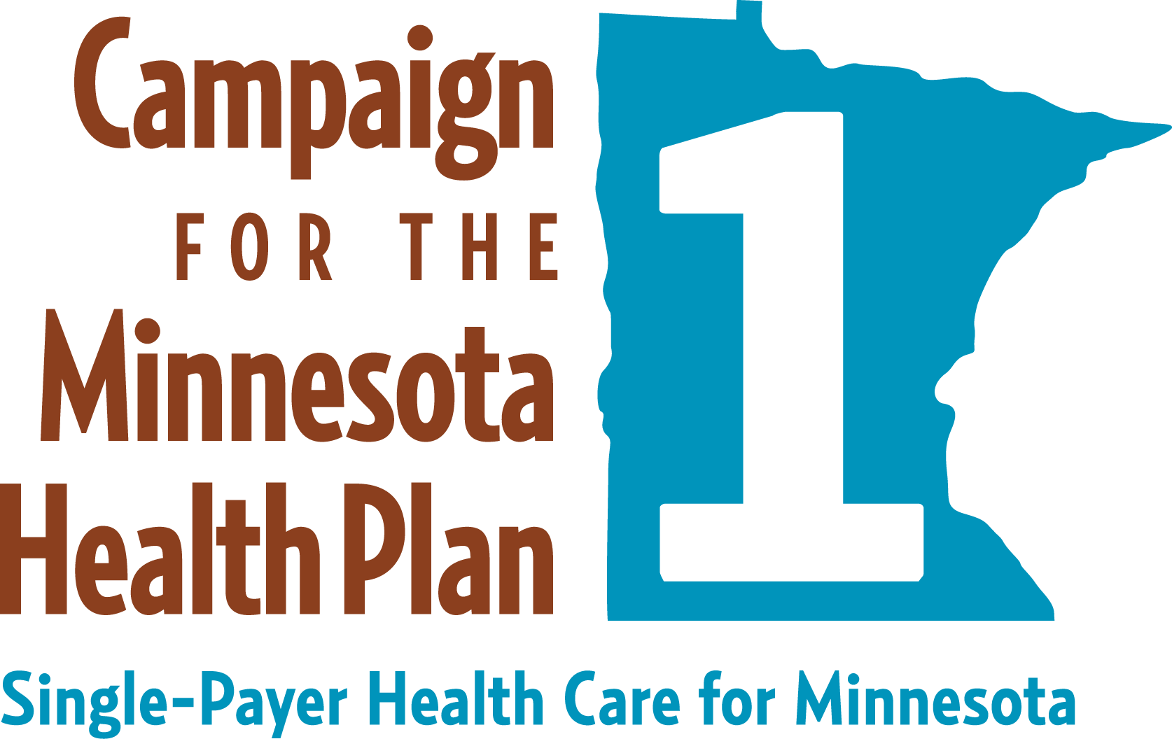
SF 8/HF 51
Chief author - Senator John Marty
Endorsed by the Duluth City Council (and then Mpls and St. Paul)
Endorsed by the Lake Superior Medical Society
Notes:
64

Slide 65
Single payer model
Universal coverage | Yes | Everyone form birth
Benefits | Yes | All necessary services
Costs | contained | Negotiated fees,bulk purchasing,
Affordability | Yes | Risk spread across entire population,
Choice of Doctor and Hospital | Full choice | All in network
Quality | Improved | Universal access early diagnosis,evidence based
More Equitable | Yes | No disparities,health becomes a right based on medical need,not a commodity based on ability to pay
Savings | Yes | $400 billion redirected in administrative waste
Progressive financing | Yes | Premiums and out of pocket replaced by progressive income distribution,95% will pay less
Sustainability Yes |  | Non for profit public financing,more accountable private delivery system will be better in the long term

Slide 66
Reconciliation Bill, aka Obamacare, or the ACA
Universal coverage | no | 23 million remain uninsured
Range of Benefits | no | Continuing reduction of covered benefits
Costs | No checks | Any gains in coverage will lead to further govt susbsidy
Affordability | no | Further stripping down:only 70% coverage,higher premiums
Choice | limited | Denial limited and restricted of care to continue
Quality improvement |  | Unlikley
Savings | No | Increased spending and costs already seen even before full implementation
Sustainability | no | Bonanza for health care private industry,entire economy at risk

Slide 67

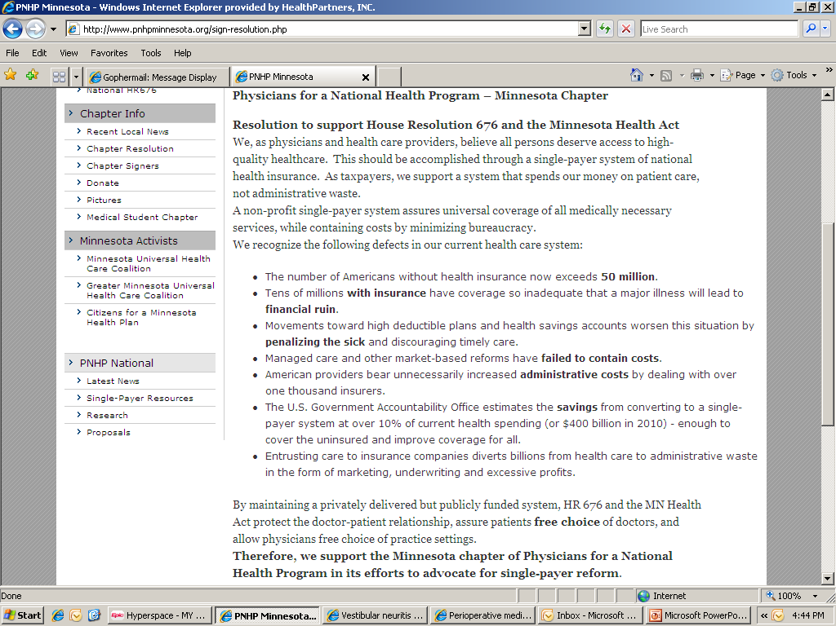

Slide 68
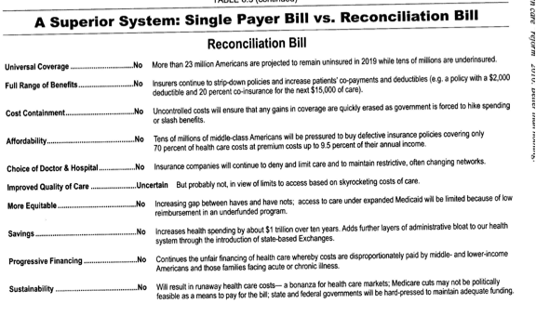

Slide 69
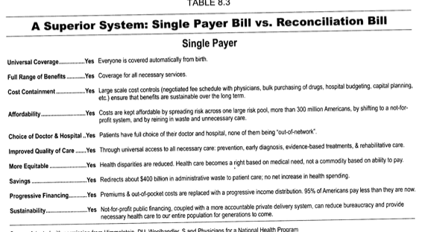

Slide 70
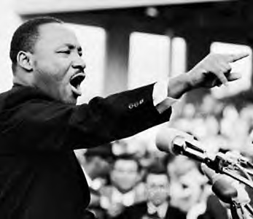
Thank you for your attention!
Educate yourself and others (www.pnhp.org)
Join PNHP
Sign our resolution
Invite a PNHP speaker to your organization or group’s event
Hear the business perspective on Thursday, Dec 8 in St. Paul
“Of all the forms of inequality, injustice in healthcare is the most shocking and inhumane.”
  - Dr. Martin Luther King, Jr.

Slide 71
The following slides were not used in the presentation – they are extras…

Slide 72
What about the masses of Canadians flooding across the border???
35 of 35,000 annual admissions to Detroit's largest hospital network were Canadian
Large population-based survey of Canadians: in one year, 0.5% received healthcare in the US, but…only 0.11% (or 20 of the 18,000 surveyed) did it intentionally!
Steven J. Katz et al., "Canadians' use of US medical services," Health Affairs 1998;17(1):225-235
Steven J. Katz et al., “Phantoms in the Snow: Canadians’ Use of Healthcare Services in the United States,” Health Affairs, May/June 2002; 21(3): 19-31

Slide 73
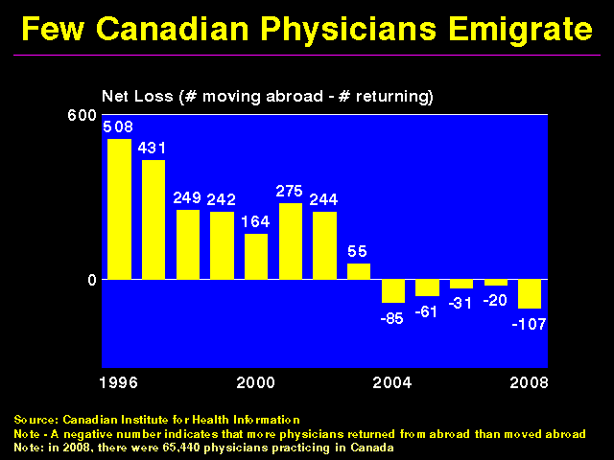

Slide 74
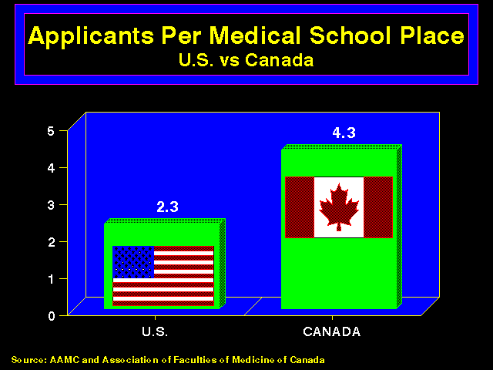
Notes:
US physicians worry about reimbursement under “Medicare for All” given that Medicare is such a poor payer here. However, important to remember there is no reason that Medicare's fee schedules should be adopted by a new program, and strong reasons why they should not be. Moreover, we do not approve of Medicare's per-patient hospital reimbursement methods, but rather prefer global budgeting. As in Canada, average physician income would be expected to remain about the same in the short term under Medicare for All. In the long term, one might expect attenuated variation in physician income.

Slide 75
Polling Data

Slide 76
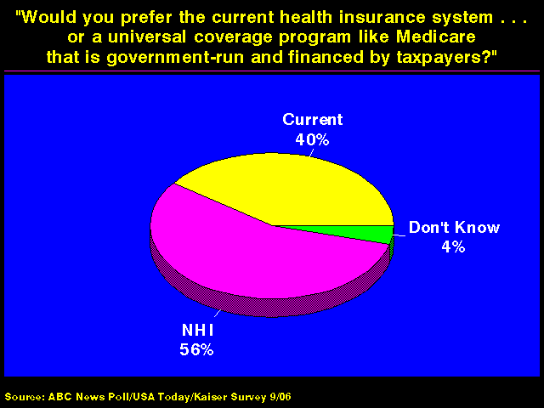

Slide 77
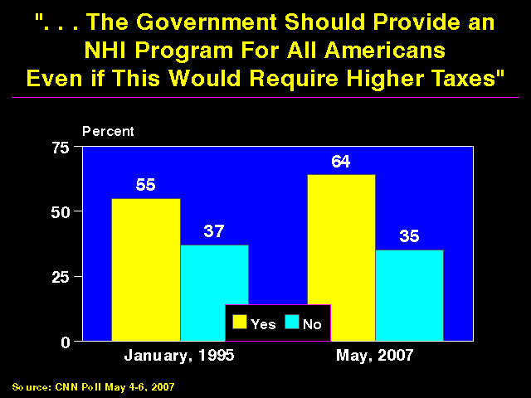

Slide 78
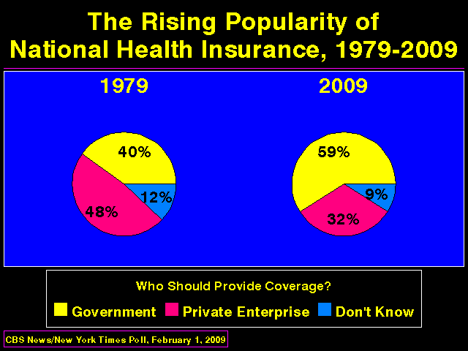

Slide 79
